Slide 1
SPDX Tooling
Zachary McFarland
GSOC Project

Slide 2

SPDX
The Software Package Data Exchange® (SPDX®) specification is a standard format for communicating the components, licenses and copyrights associated with a software package. (SPDX.org)

Slide 3
Purpose of the GSoC Project
Create a user friendly interface to ease companies adoption of the SPDX standard.
Provide companies with an internal repository to manage SPDX documents.
Combine multiple scanning utilities to create higher definition SPDX documents.

Slide 4
Components
DoSPDX
SPDXDash
Command line program that scans software packages for license and copyright declarations.
DoSPDX Github Repo
Web based SPDX repo used to manage and maintain internal SPDX docs.
SPDXDash Github Repo

Slide 5
Components
FOSSology
Ninka
License scanning utility originally developed by Hewlett Packard.
Analyzes all of the source code for a project and intelligently reports all of the licenses being used.
Uses license declarations and common phrases that identify software licenses.
Ninka is a lightweight license identification tool for source code.
Capable of identifying several dozen different licenses (and their variations).
Ninka is the result of a research project aimed at identifying licenses in source code.

Slide 6
DoSPDX
Scans software packages with both FOSSology and Ninka to produce a higher definition SPDX document.
Prints SPDX documents in either RDF or TAG formats.
Caches document, license, and file information in a database, to increase the speed of future scans.

Slide 7
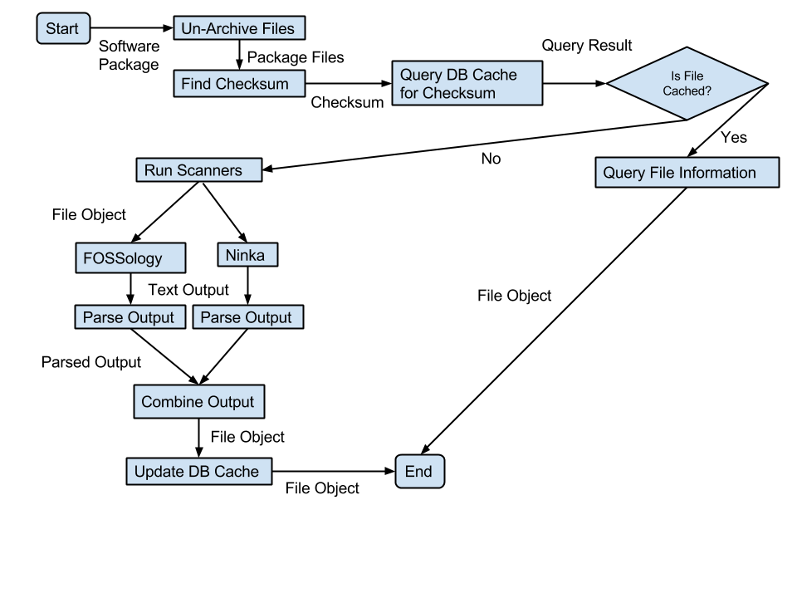
DoSPDX: How It works

Slide 8
SPDXDash
Simple interface for browsing and searching SPDX Documents scanned by DoSPDX
Provides the capability for uploading software packages to be scanned by DoSPDX.
High definition editing of SPDX documents.
Allows for downloading of SPDX documents in RDF or TAG format.

Slide 9
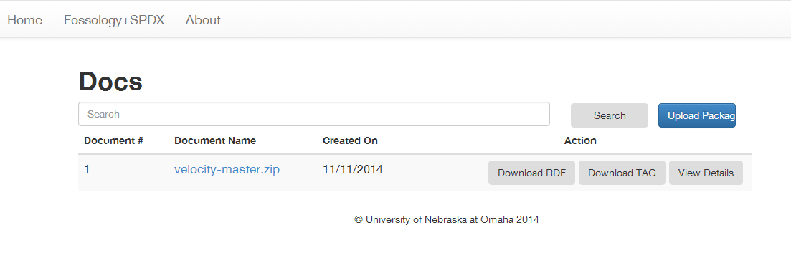
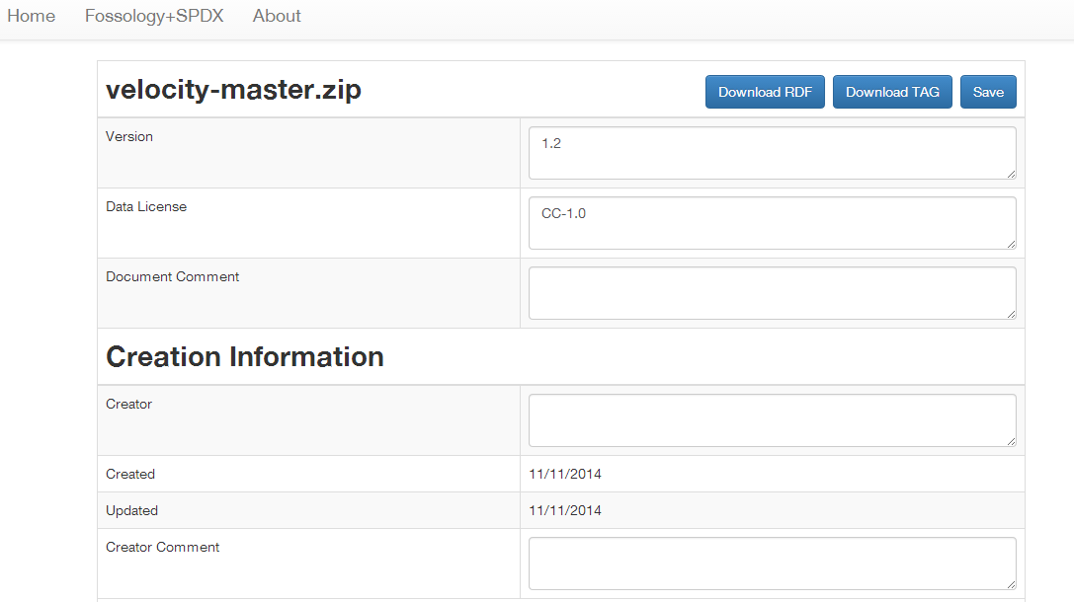
SPDXDash
Clean, Easy to read and use interface.
Using SPDX Dashboard you can search and browse all of your cached documents.
Edit every field of your documents.
Download your documents in RDF or TAG.

Slide 10
Future Work
Uploading pre-existing documents to your SPDX repo.
Ability to download your documents in JSON format.
Further enhance performance of DoSPDX scanning process.
Make modifications based on future user feedback.

Slide 11
Questions

Slide 12
Sources
"SPDX | Software Package Data Exchange." SPDX | Software Package Data Exchange. Linux Foundation, 2013. Web. 15 Aug. 2014.
SPDX Logo. Digital image. SPDX. Linux Foundation, 2013. Web. 15 Aug. 2014.
"FOSSology." - About Us -. N.p., 2011. Web. 17 Aug. 2014.
German, Daniel M., and Yuki Manabe. "Ninka, a License Identification Tool for Source Code." Ninka, a License Identification Tool for Source Code. N.p., 22 Jan. 2011. Web. 17 Aug. 2014.

Slide 13
Licensed Under Creative Commons
Attribution-ShareAlike 3.0 Unported (CC BY-SA 3.0)
Users of this material are able remix, tweak, and build upon this work even for commercial purposes, as long as they credit the contributors and license their new creations under the identical terms. All new works based on this material will carry the same license, so any derivatives will also allow commercial use.
http://creativecommons.org/licenses/by-sa/3.0/

